Slide 1

GIT

Slide 2
What is a version control system?
record changes
roll back
ideally: integrate work
ideally: enable collaboration

Slide 3

Distribution
Local
Centralized
Distributed

Slide 4
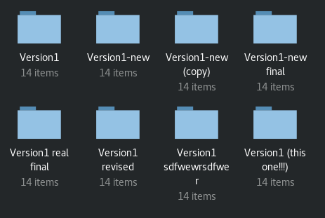
Distribution
Local
Centralized
Distributed

Slide 5
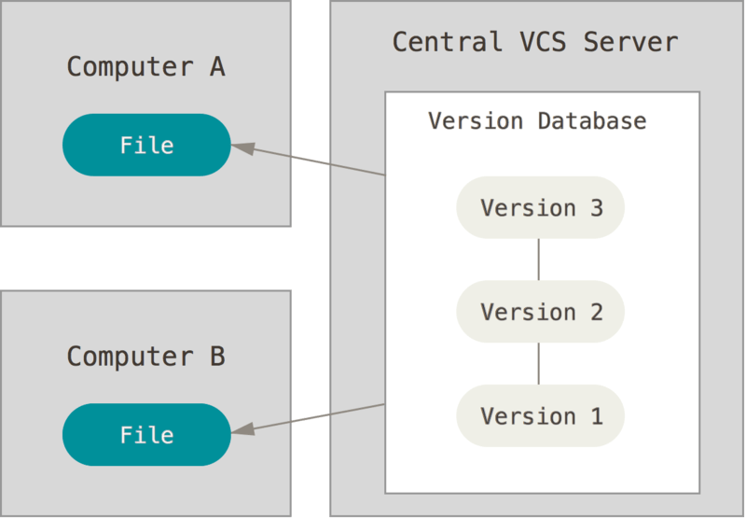
Distribution
Local
Centralized
Distributed

Slide 6
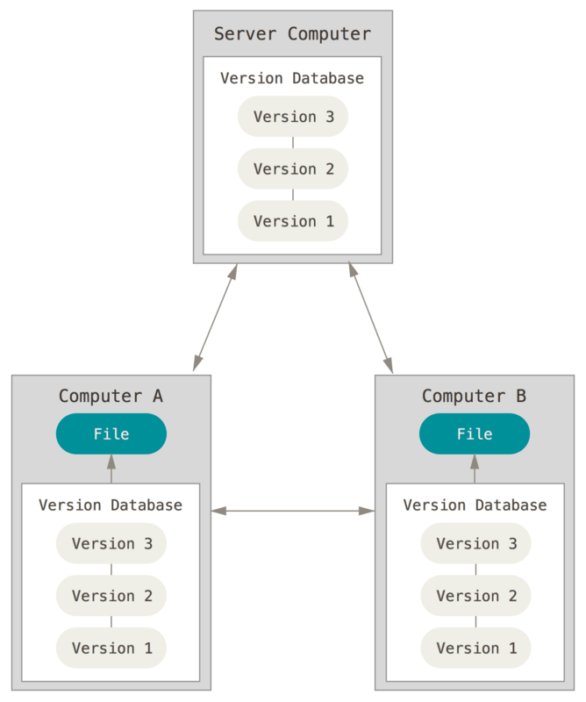
Distribution
Local
Centralized
Distributed

Slide 7
“Git is not a version control tool.
It's a graph-manipulation tool that supports version control methodologies.”

Slide 8
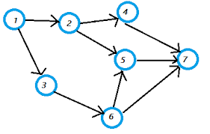
The Commit Graph

Slide 9
The Commit Graph
The fundamental data structure of git
Directed acyclic graph (DAG)
Nodes are commits (snapshots of directories)
Edges represent ”line of evolution”/”flow of code” (not necessarily chronological history)
What is it?

Slide 10
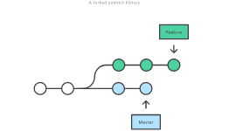
Branches
The “pointers” of GIT

Slide 11
Anatomy of a Commit

Slide 12
Basic Objects
Represents a file
Addressable by the SHA1 hash of its content
Does not contain any file metadata
Blobs
Trees
Annotated Tags
Commits

Slide 13
Basic Objects
Basic git object
Represents a directory
Contains pointers to blobs and other trees
Records file permissions and names of those blobs/trees
Addressable by SHA1 of all internal data
Blobs
Trees
Annotated Tags
Commits

Slide 14
Basic Objects
Annotated tags are full objects, as opposed to lightweight tags, which are just pointers
Created with git tag -a
Like a branch that doesn’t ever move/change
Contains author, commit message, can be signed
Blobs
Trees
Annotated Tags
Commits

Slide 15
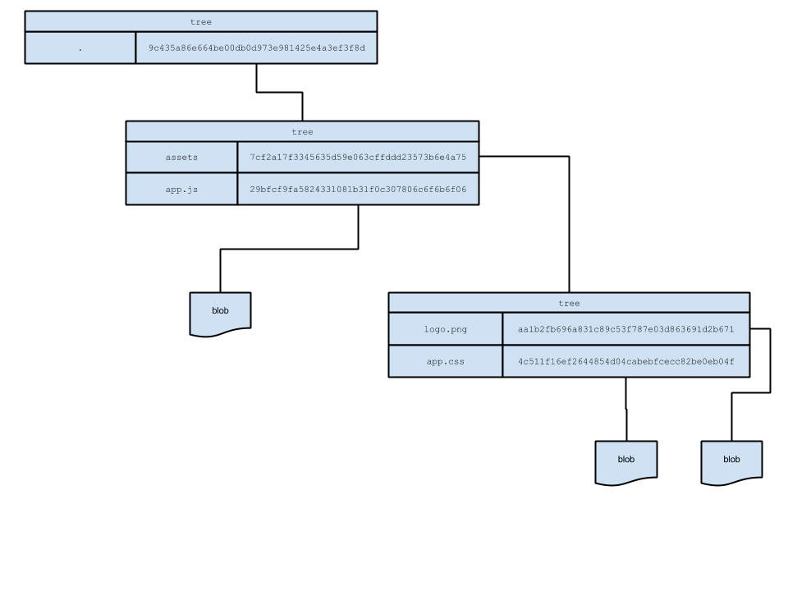

Slide 16
Basic Objects
Contains:
Hash of tree
Hash of parent commit(s)
Author name, email, timestamp
Committer name, email, timestamp
Commit message
Its hash is the SHA1 of the above information
Hash uniquely identifies commit content and history
Blobs
Trees
Annotated Tags
Commits

Slide 17
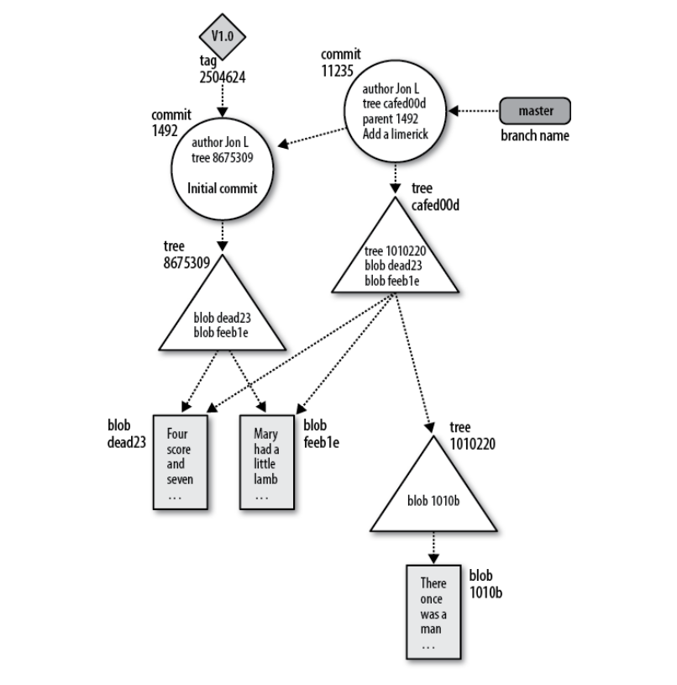

Slide 18
Creating a commit
Index is “tree for next commit under construction”
Files are explicitly added to index with git add
Files in working dir are tracked, ignored or untracked
Tree created from index on commit
git status queries working dir and index git ls-files shows all files in index.
To remove files from index: git rm (both index and working dir) or git rm --cached (only index)
The index
Committing on a branch
Merge commits

Slide 19
Creating a commit
Can only commit if you are on a branch
Previous commit on branch becomes parent
Branch pointer is updated: now points to new commit
The index
Committing on a branch
Merge commits

Slide 20
Creating a commit
Created when two or more branches are merged
Has two or more parents
The index
Committing on a branch
Merge commits

Slide 21
What is a commit?
Interpretation 1: A snapshot of files and directories
i.e. “commit = tree-object”
Interpretation 2: A patch-set, relative to the previous commit
i.e. “commit = diff”

Slide 22
When to commit?
No definitive answer
Commits are cheap, and small patch-sets are easier to understand, so commit often
Heuristic: git diff should be meaningful
Try to avoid pork-barrel commits
No-one cares what you do on a private branch, but it’s nice to keep public history browsable.

Slide 23
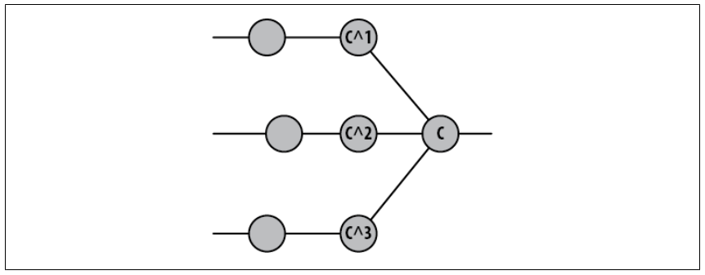

Slide 24
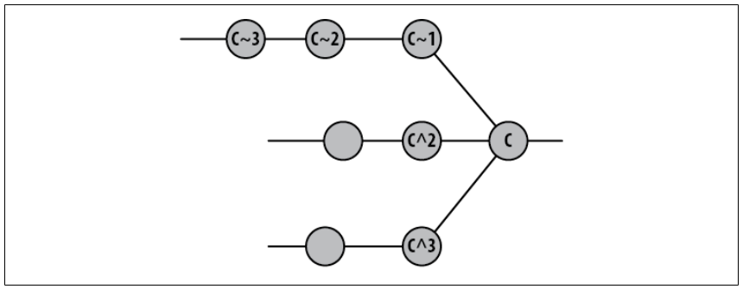

Slide 25
Branches

Slide 26
What are branches
Pointers to commits
Represent a separate line of development
Exist in .git/refs/heads
Currently checked out branch is referred to by the HEAD pointer, and is found in .git/HEAD
Commits and blobs which are not on any branch will eventually be garbage-collected

Slide 27
Manipulating branches
Creating without checking out: git branch <name>
Checking out branch: git checkout <name>
Creating and checking out: git checkout -b <name>
Names can contain slashes for namespacing
Deleting branches: git branch -d <name>
Listing all branches: git branch

Slide 28
Rolling Back/Moving the Branch
Moving a branch: git reset <commit>
Moving a branch and checking out its tree in the working directory: git reset --hard <commit>

Slide 29
I Lost My Branch
Accidental delete, botched a rebase/merge, ...
Don’t panic. Garbage collection won’t happen for days.
git reflog
Checkout a commit directly: git checkout <hash>
Called “detached head state”
Recreate a branch on the commit with git branch

Slide 30
Integrating Work
Merging and Rebasing

Slide 31
Merging
E.g.: finished finished feature. Time to integrate development into main branch.
Git first checks if merge is fast-forwardable
Otherwise does a three-way merge and creates a merge commit
Merging feat into master: While master is checked out, git merge feat
Force no-fast-forward merge: git merge --no-ff feat

Slide 32
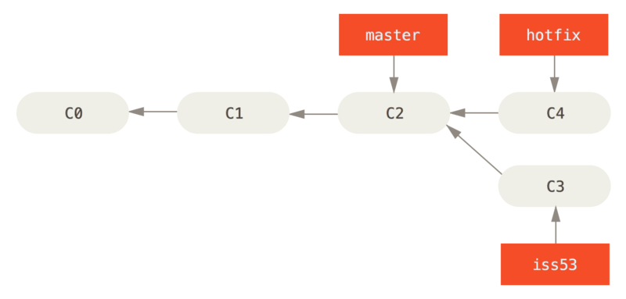
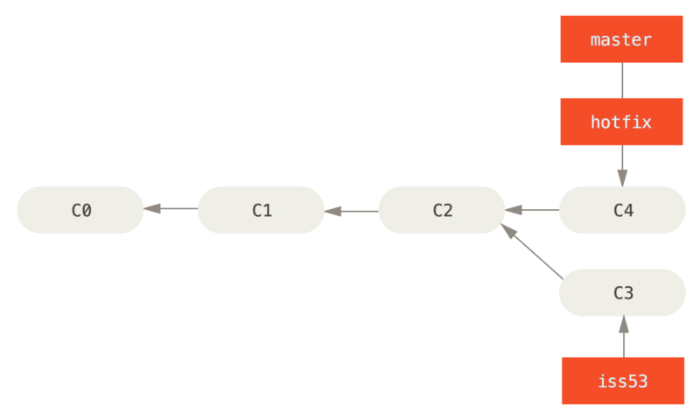

Slide 33
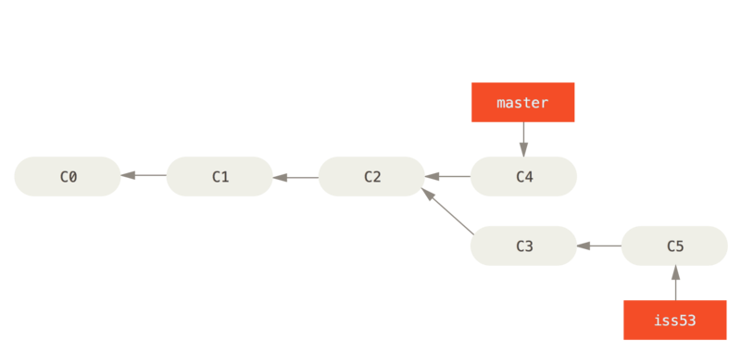
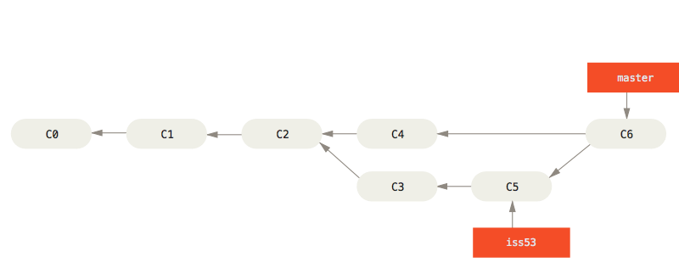

Slide 34
Rebasing
Altering history by moving a branch and “replaying” the changes on a different base commit
While on branch feat: git rebase <ref>, e.g. git rebase develop
Note: rebase discards merge-commits on the branch that is being rebased unless you add --preserve-merges

Slide 35
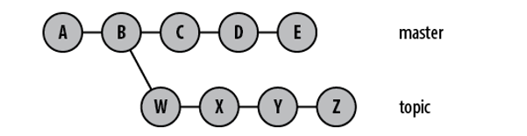
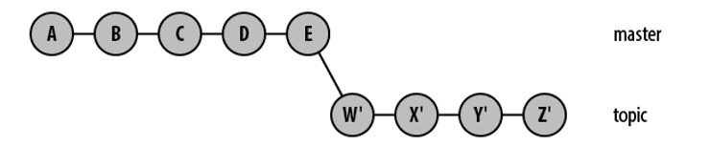

Slide 36
Distributed GIT

Slide 37
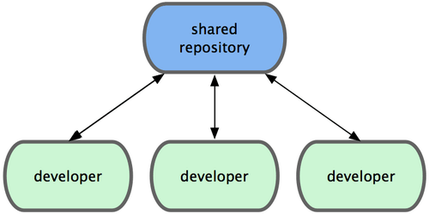
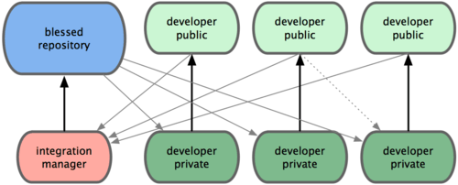
Different Distribution Models

Slide 38
Remote Repositories
Repositories which you get code from (upstream)
git remote
Usually you will have one upstream repository, and it is conventionally called origin

Slide 39
Remote Tracking Branches
Origin is just another git repo with own branches, commits, tags…
Must explicitly track a branch on origin to coordinate histories on push/pull
Found in .git/refs/remotes/origin/<branch>
git branch -vv
First time you push a new branch to origin, you do this explicitly: git push --set-upstream origin <branchname> or equivalently git push -u origin <branchname>
If you checkout branch from origin, this happens automatically

Slide 40
Remote Tracking Branches
In order to get the latest history from the tracked branch, you will often do git pull
This fetches commits/blobs/trees you don’t have locally, then merges the remote branch into corresponding local branch
git pull == git fetch && git merge FETCH_HEAD

Slide 41
Remote Tracking Branches
If you want to force-move the remote branch (i.e. force-rewrite history), you can use git push --force.
Note: some origins will have protected certain branches against this
If someone has force-rewritten the history of a branch you are following, you have to force-move your local branch in return: git fetch && git reset --hard FETCH_HEAD

Slide 42
Workflows

Slide 43
What everyone agrees on
At least one branch is special, and holds the latest stable code for a step in the development cycle. Usually called master. Others include develop and staging.
Development should happen in “topic-branches”, which are merged into a special branch. Often further split in feature/fix/hotfix.

Slide 44
Two philosophical approaches to git
Git history should accurately represent the development history
Merge-based workflows
The git history is a collaborative patch-set, which describes how functionality evolves
Rebase-based workflows
Different workflows

Slide 45
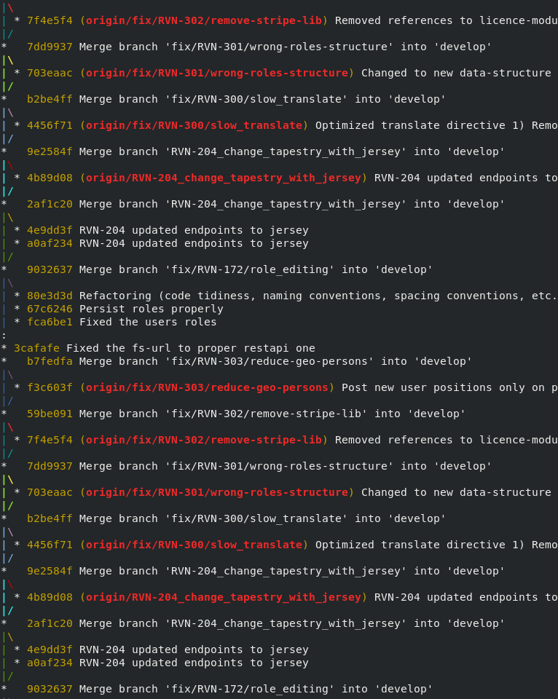
The Rayvn Workflow
“Patch-set” approach
Feature branches are rebased on develop before merging
They are then merged --no-ff
When develop reaches a production-ready stage, develop is merged into master.

Slide 46
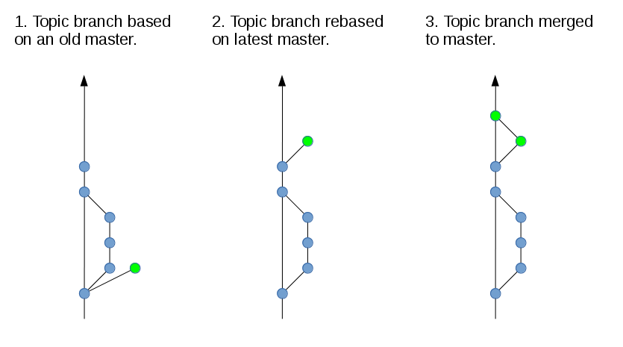

Slide 47
Repository Managers
GitHub, GitLab, Bitbucket, etc
Add collaboration tools on top of bare git
Importantly: pull requests/merge requests

Slide 48
Exercises

Slide 49
You are done with your feature branch. What do you do now?

Slide 50
You rebased a feature branch. How do you update the remote branch?

Slide 51
When you started your new feature branch, you accidentally did so from another feature branch instead of dev. What do you do?

Slide 52
Remote history was rewritten.
What happens if you do an ordinary git pull?
You need to update your local branch so that it is identical to the new remote branch. How?

Slide 53
A hotfix was committed straight to master. You now need to integrate the same work on develop. How?

Slide 54
A and C work on the same feature branch. Both start on the same commit. A commits his new work. C then tries to commit his. What happens?

Slide 55
A initializes a new git repo and stages and commits a file. M later does the same to an identical file with identical content. Are the repositories identical?

Slide 56
M and C work on the same feature branch. Both start from the same commit. M commits and pushes his new work to origin. C then tries to commit and push his work. What happens?

Slide 57
Your last commit contained a small typo/a small error which was quickly fixed. You now have a contentful commit followed by a quick “fix”-commit. How could you tidy this up?

Slide 58
You deleted your feature branch and checked out another branch by accident. No work was pushed to origin. How do you recover?

Slide 59

Create a repo which looks like the one to the right.
Then: start a new feature branch on commit A

Slide 60
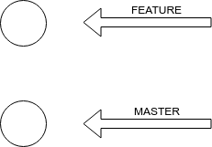
Create a commit graph which looks like this
What happens if you try to merge the branches?

